Slide 1

MIAi 504
Neural Networks and deep learning
  MIAI – 2026/2027
Dr. Zein Al Abidin IBRAHIM
zein.ibrahim@ul.edu.lb

Slide 2
neural networks:
A Quick overview
DEEP LEARNING

Slide 3
Transfer learning
DEEP LEARNING

Slide 4
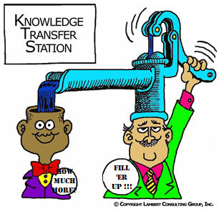
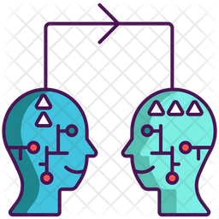
Definition
Definition: Transfer learning reuses knowledge gained from a pre-trained model on a new task, saving time and resources.
Think of it as: Building upon existing expertise instead of starting from scratch.

Slide 5
Advantages of transfer learning
Faster Training: Pre-trained models have already learned low-level features, reducing training time for new tasks.
Less Data Required: Smaller datasets suffice for fine-tuning, making it ideal for scenarios with limited data.
Improved Performance: Leveraging pre-trained knowledge often leads to better accuracy and generalization compared to training from scratch.

Slide 6
Potential Drawbacks
Domain mismatch: Pre-trained knowledge might not perfectly translate to the new task, leading to suboptimal performance.
Negative Transfer: Pre-trained biases can hinder learning on the new task, requiring careful selection and adaptation.
Computational Overhead: Fine-tuning a pre-trained model can still be computationally expensive, especially for large models.

Slide 7
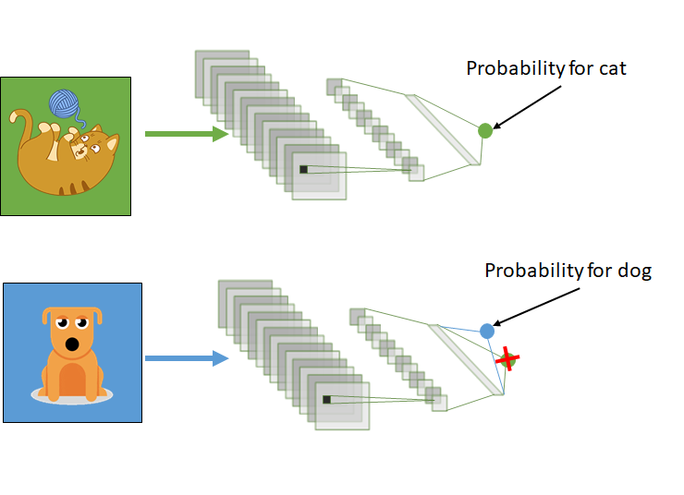
Example

Slide 8
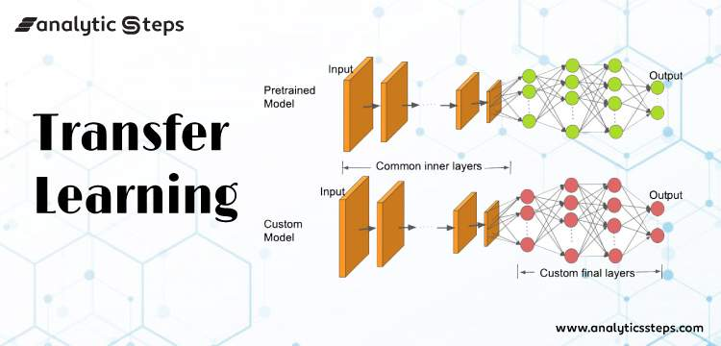
How it works?
In computer vision → The neural network aims to:
  detect edges in the first layer(s),
  detect forms in the middle layer(s),
  and task-specific features in the latter layers.
early and central layers are employed in transfer learning, and the latter layers are only retrained

Slide 9
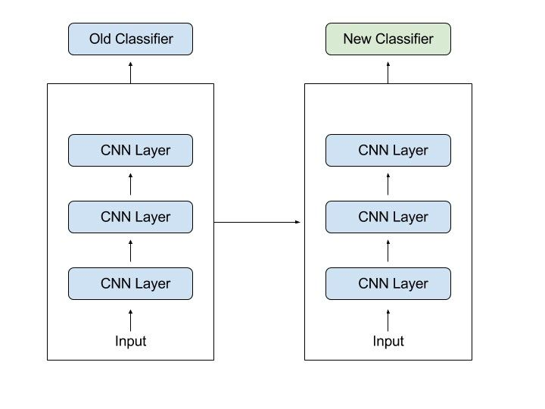
How it works?

Slide 10
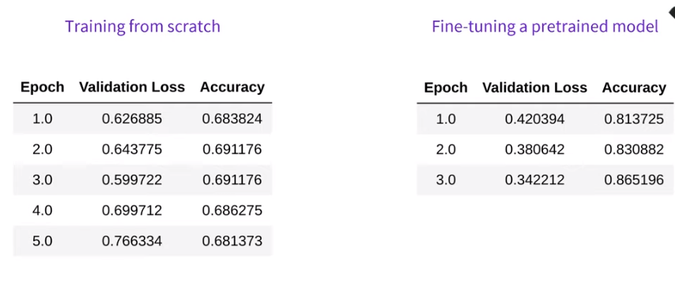
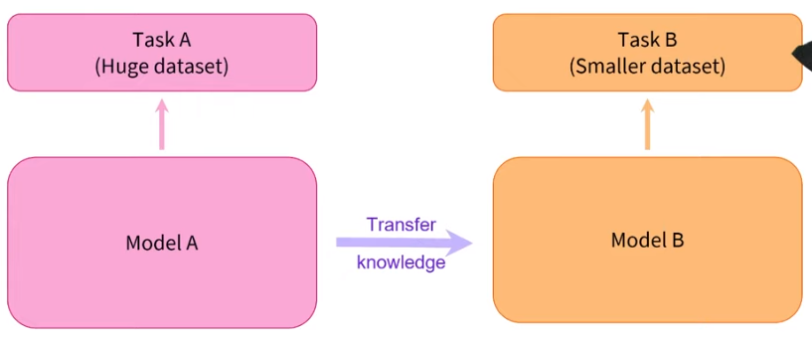
Training from scratch vs using pre-trained model

Slide 11
How to use transfer learning
Use pre-trained models without any modification
Change the last layer responsible of the classification and train the new weights and freeze all the other weights in the other layers
Same as 2 but re-train all the network
Remove more than the last layer and add as much layers at the end as you want and train the weights of the added layers or all the weights as you want
  You should have enough data and resources to train a complete network

Slide 12
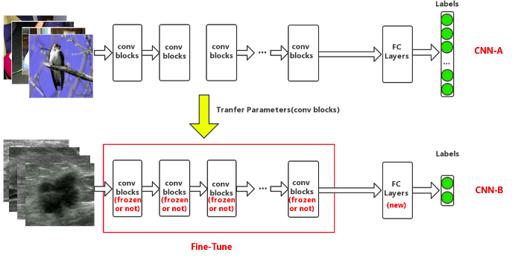
Types of transfer learning

Slide 13
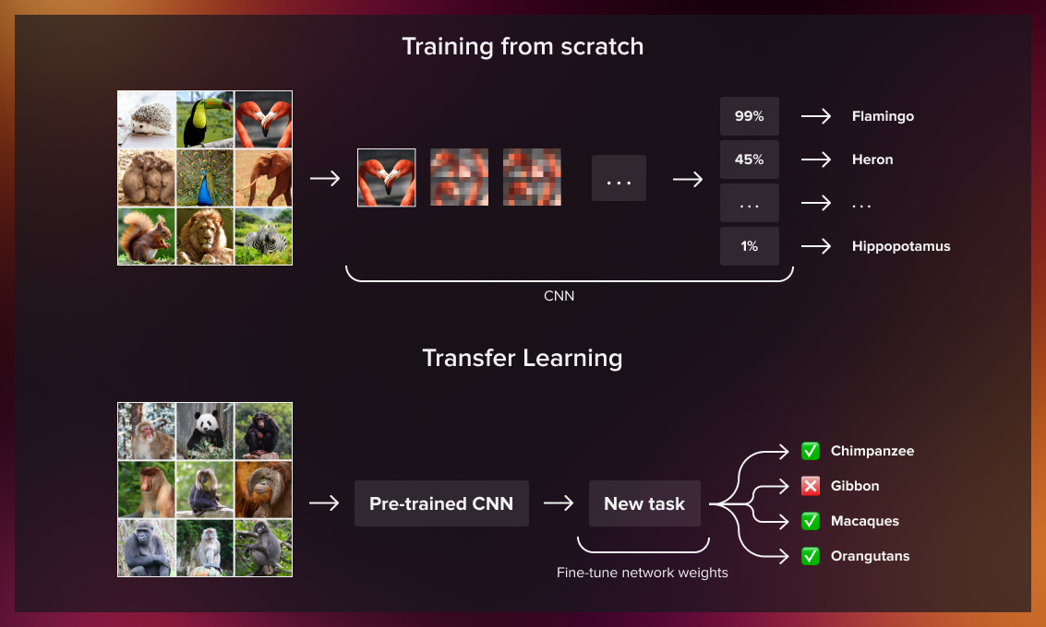
Types of transfer learning

Slide 14
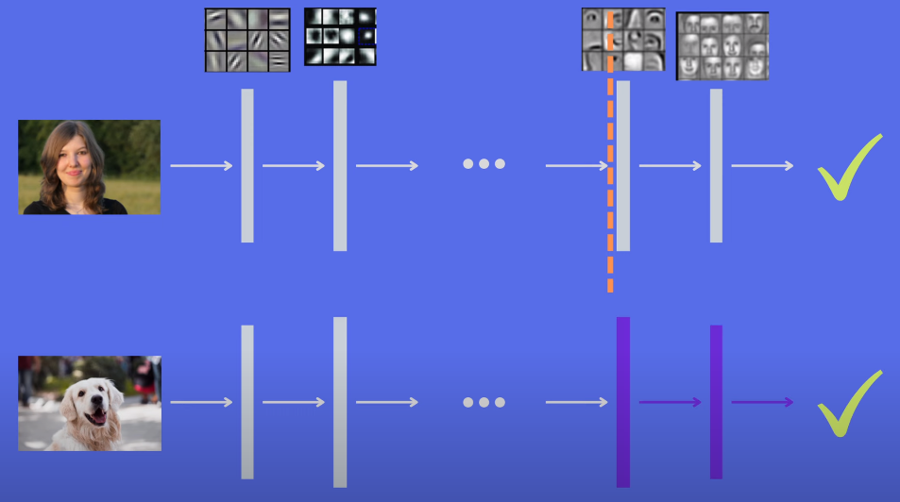
How to use transfer learning
Task A → recognizing human faces
Task B → recognizing dog faces.
Here → removing the last layer is not enough because the before last layers detect high level features corresponding to humans not dogs so you remove more layers
  Number of layers to remove depends on how much tasks are similar.

Slide 15
When transfer learning makes sense
To use transfer learning from task A to task B you should consider:
  Tasks A and B have the same input
  We have more data for task A than task B
  Low level features from task A could be valuable for learning B

Slide 16
Where to find pre-trained models
Deep learning frameworks
  Tensorflow hub → https://www.tensorflow.org/resources/models-datasets
  Keras applications → https://keras.io/api/applications/
  Pytorch → https://pytorch.org/vision/stable/models.html
  Hugging face → transformer-based models
  Kaggle
  Model zooz
  …

